Slide 1







University of Hail
College of Computer Science and Engineering
CSCE242 - Human-computer Interaction
Sec: 205
Groub 4:
Lama
Ishraq Freah
Abhar
Alanoud
Bushra
Rana
DR: NAJLA BAGAIS

Slide 2






Outline
Introduction
Problem finding
Design processes
Research
Requirement
Design
Evaluation
Conclusion
Questions slide
END

Slide 3

Introduction
The Zara application is a mobile application developed by the well-known fashion retailer, Zara.
It is designed to provide an enhanced shopping experience for customers who prefer to shop using their smartphones or tablets.
One of the key features of the Zara app is its With the Zara app, users can explore a wide of fashionable clothing items, including apparel for men, women, and children.

Slide 4





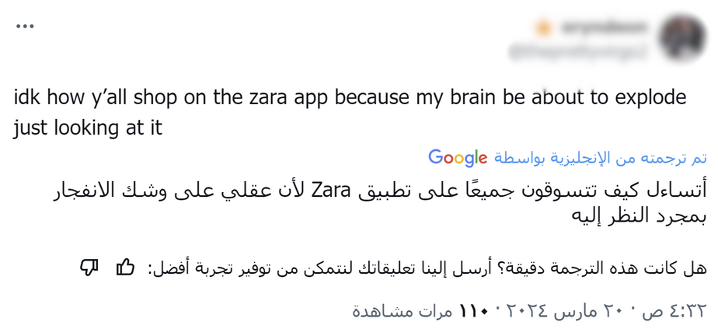

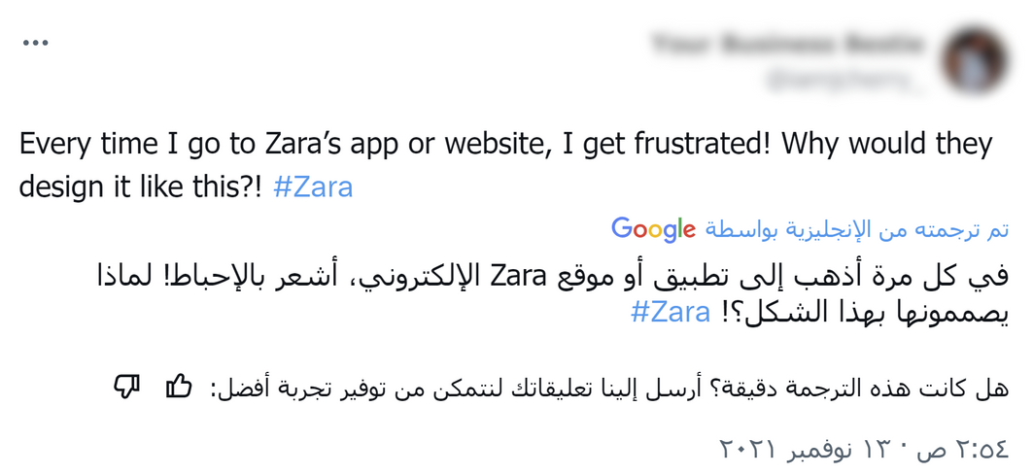

Problem finding
Problems:
First, before we started working on the Zara application, we noticed a lot of criticism on the Twitter(X) platform regarding the design
lack of guidance and guidance.
inconsistent design.
difficulty in navigating and exploring.

Slide 5




We used a user-centered design (USD) approach.
research
requirements
design
evaluation

Slide 6


The first stage was research
1 - research
This stage focuses on collecting data through different methods
We collected our data through a survey, and the group we targeted was 20 adults.

Slide 7
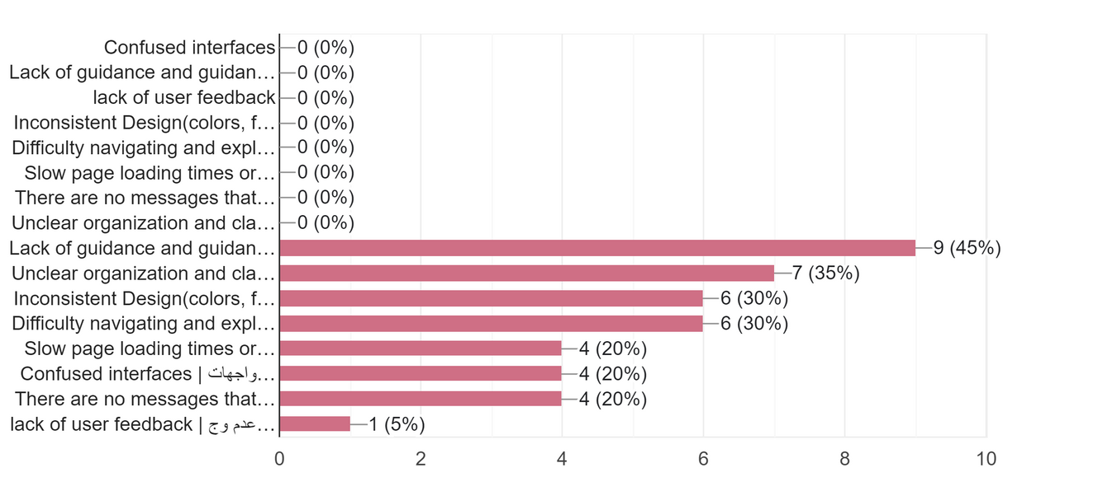
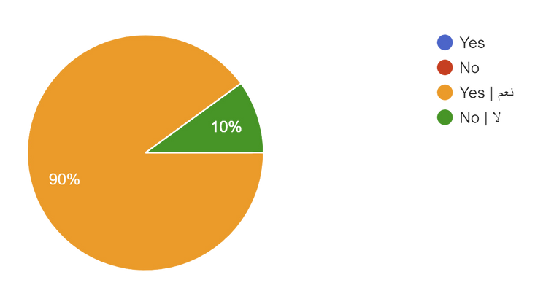
The second stage was the Requirements
Regarding the first problem, which is the lack of guidance and guidance.
It was one of the most prominent and common problems in the Zara application
2 - requirements
Because of its importance because it leads the customer to confusion and uncertainty, we note that 90% agreed on that

Slide 8

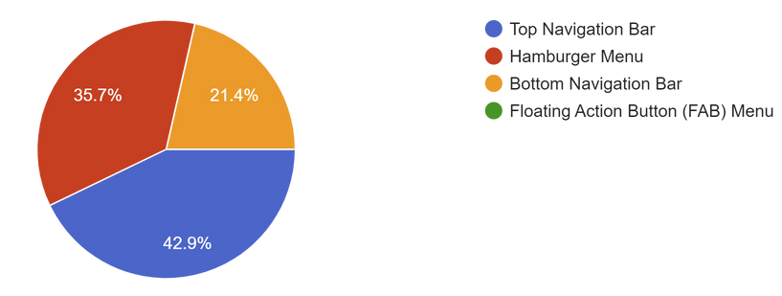
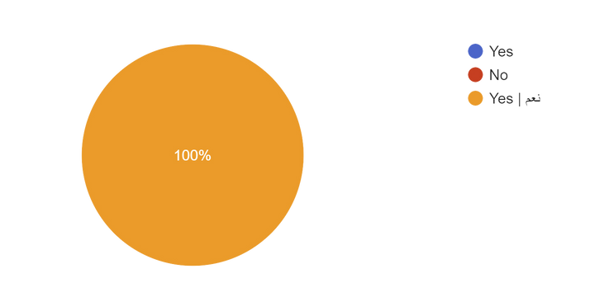
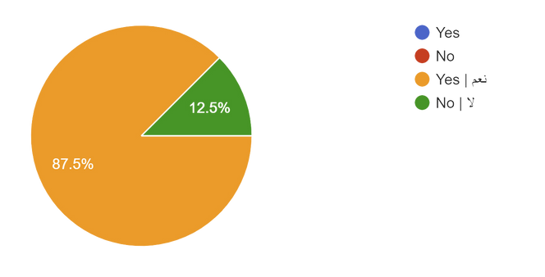
The second stage was the Requirements
The second problem was the inconsistent design.
This was the problem that customers faced after the first problem
Firstly. Menu:
2 - requirements
“Top Navigation Bar” was chosen to design the menu in this way by 42.9%
It should also be enhanced with pictures and the percentage was 100%

Slide 9
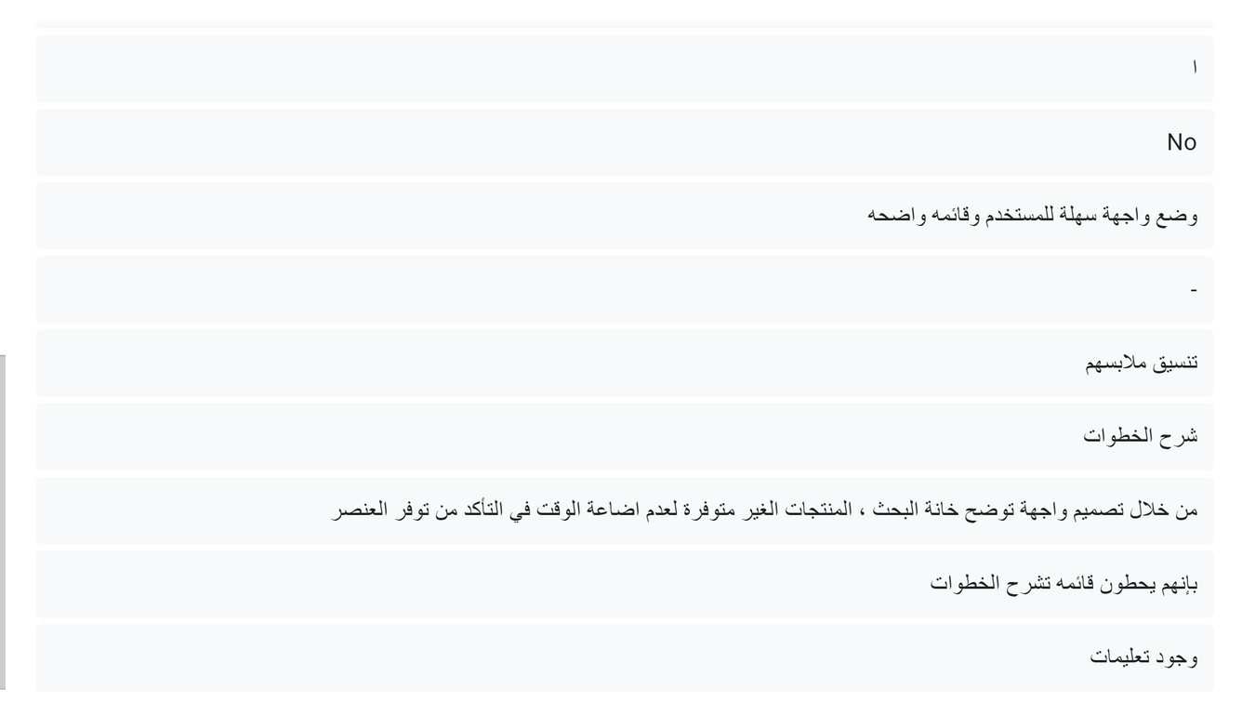
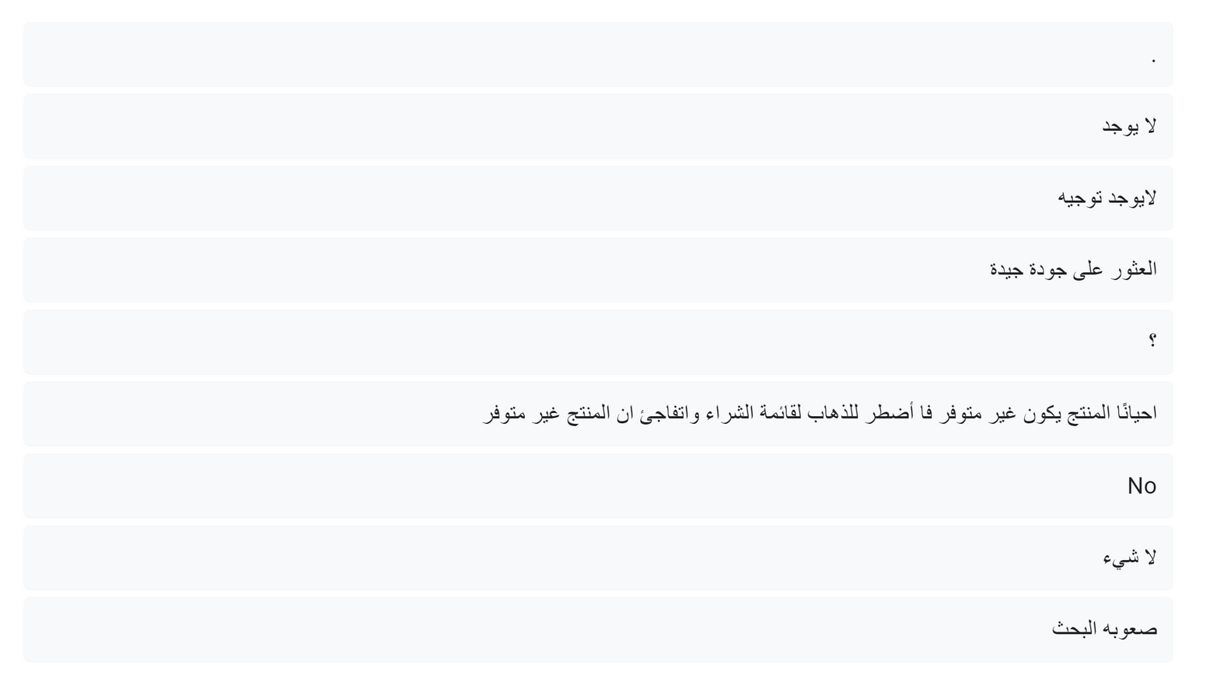
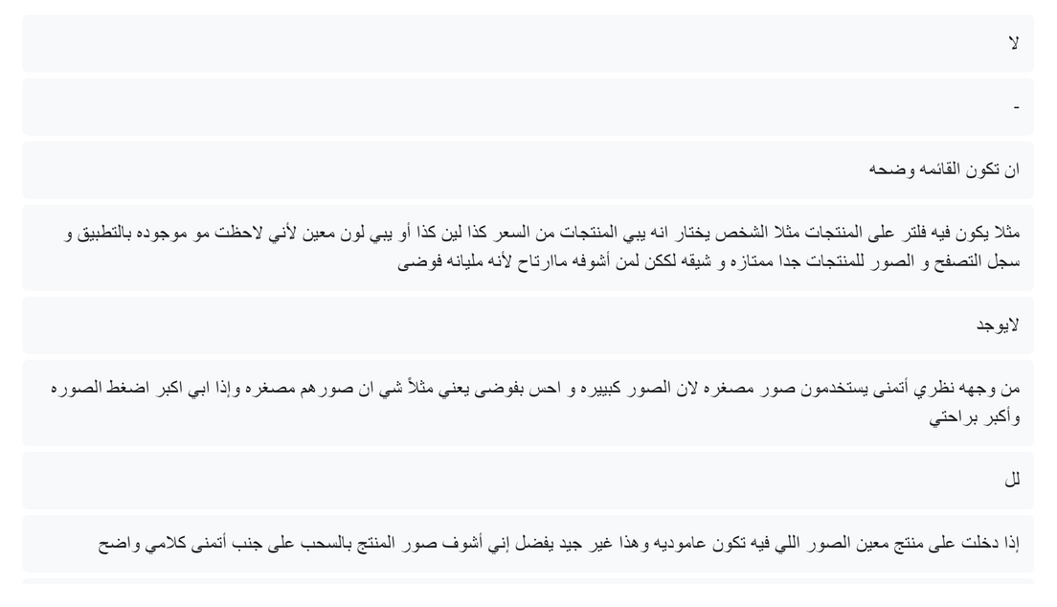
The second stage was the Requirements
The second problem was the inconsistent design.
secondly. Product List:
This was the problem that customers faced after the first problem
2 - requirements
In the beginning, there is a problem that is considered important and we overlooked it, but in the questionnaire, many people answered us that if the product is not available on the list, they do not write about it, but if it is transferred to the cart, it is discovered that the product is not available
Secondly, the pictures in Zara are vertical, and this is something that bothered customers
Thirdly, the percentage of customers’ need for a product evaluation list was 100%

Slide 10
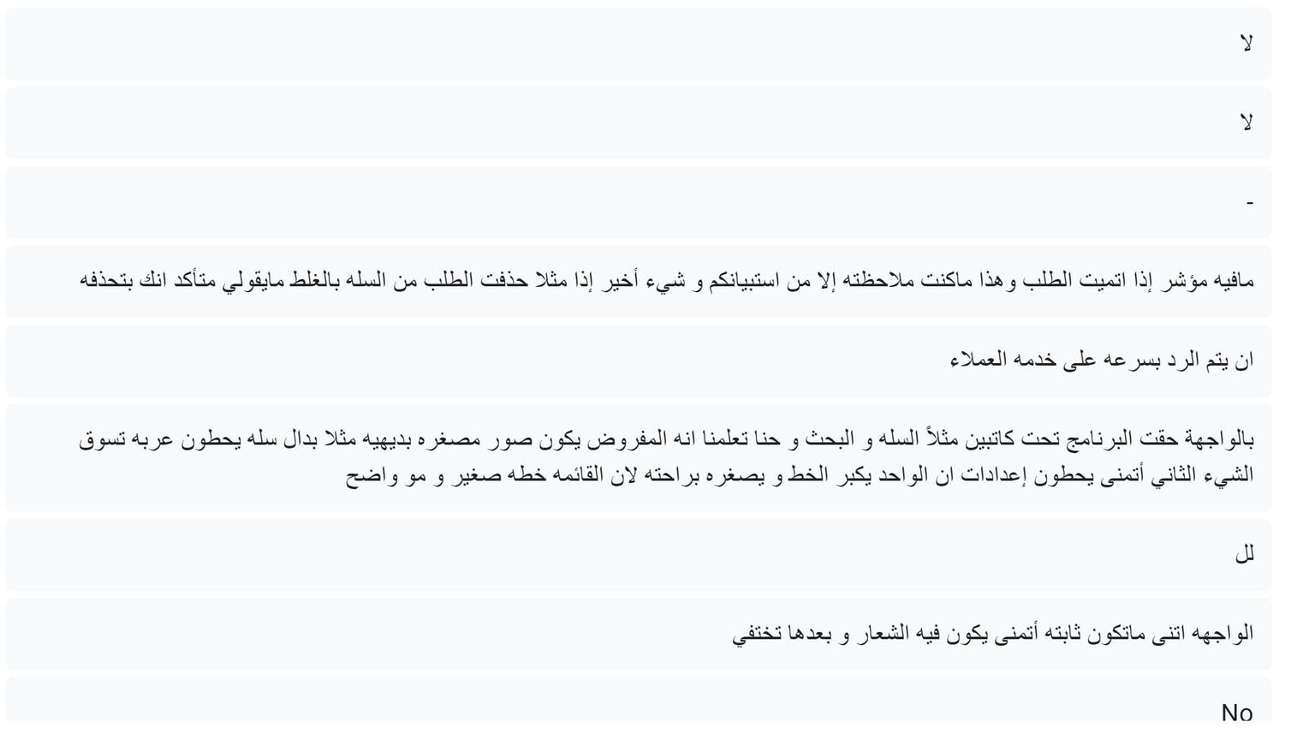
The second stage was the Requirements
The second problem was the inconsistent design.
This was the problem that customers faced after the first problem
Third. Shopping cart:
2 - requirements
There must be an indicator to track the completion of the request. The problem of the lack of error-preventing messages must also be solved

Slide 11
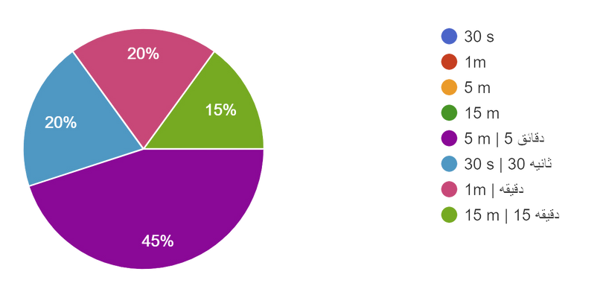
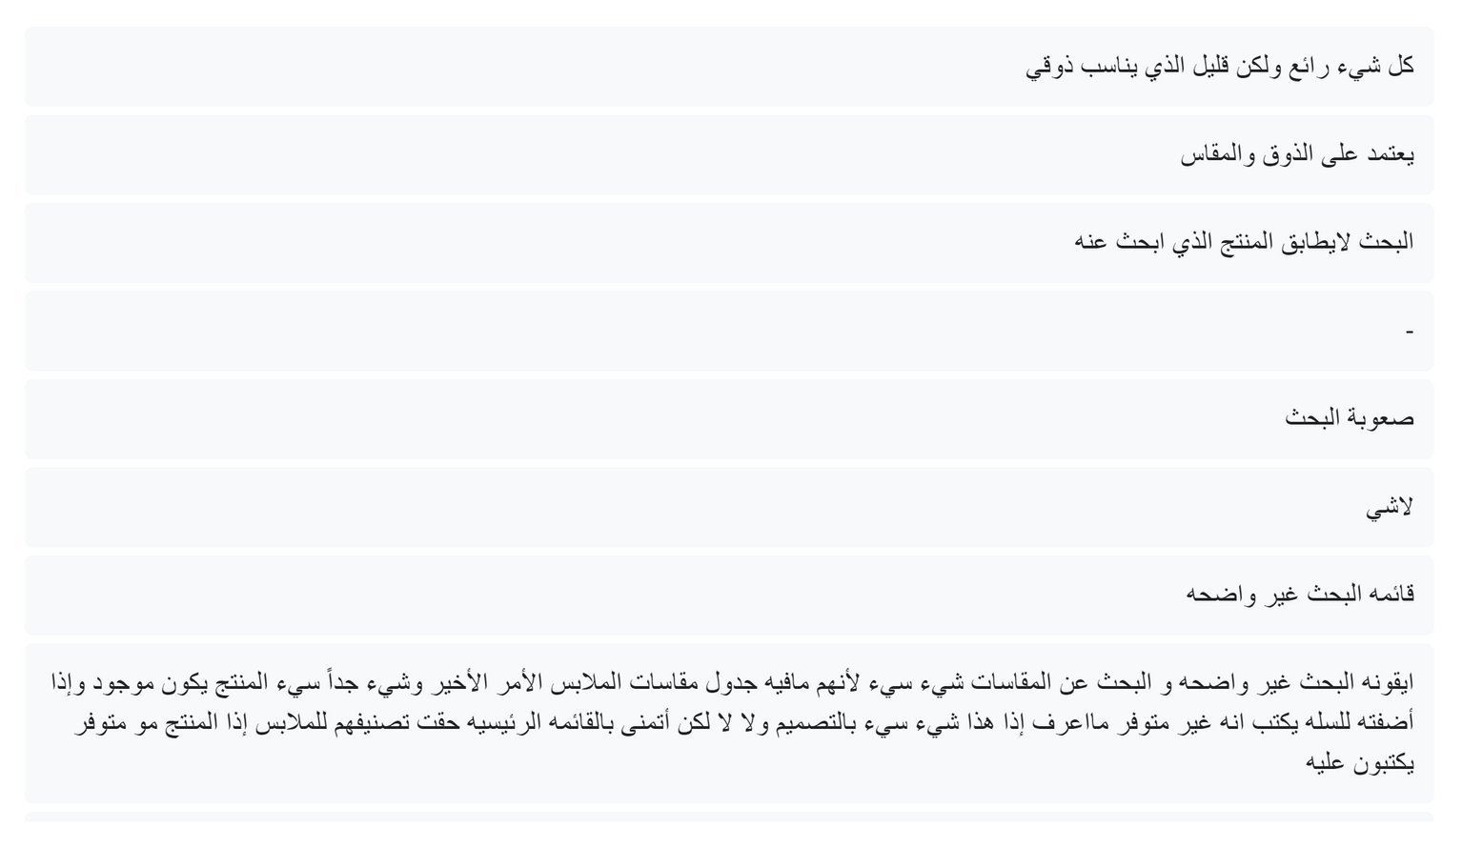
The second stage was the Requirements
The third problem was difficulty in navigating and exploring.
2 - requirements
When we ask how long you search for a product, we notice The average search was 5 minutes
Also, their search did not match the product they were looking for

Slide 12

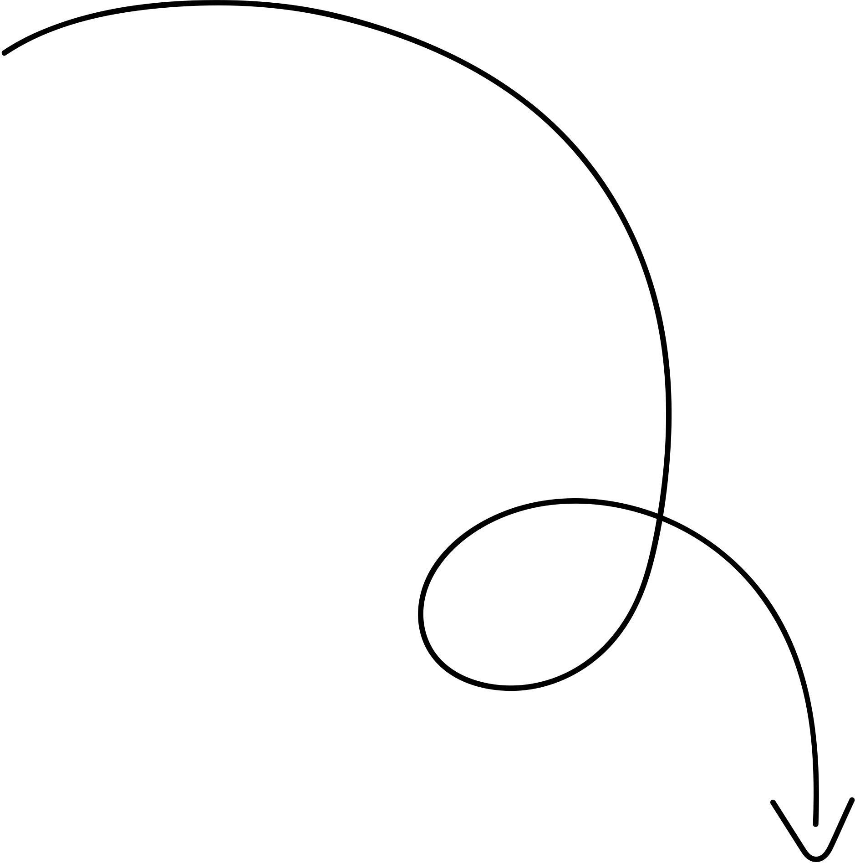

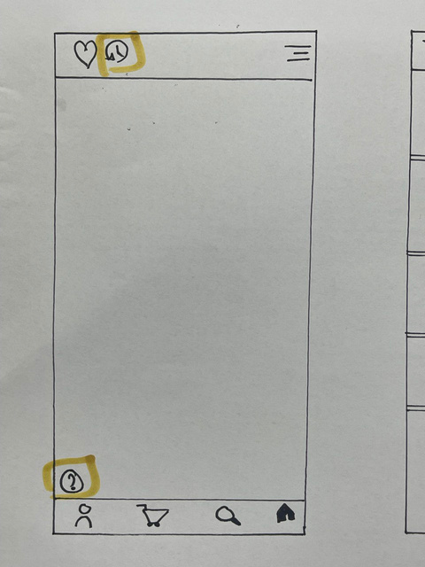
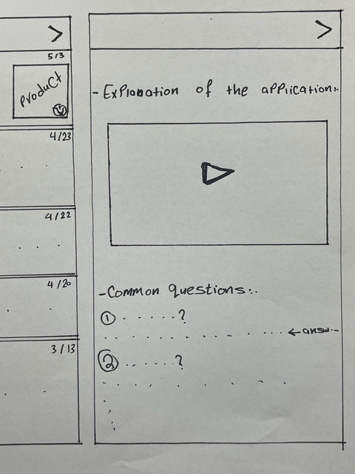
It was in two stages
Homepage
The first. "low prototype"
The goals of the first stage are that errors are easy to correct and discover before designing the program, and that they are also low-cost
3- Design
Here on the main page, the location of the menu has been changed. We have also added an option to explain the program.
Explanation of the application
if a customer encounters a problem, they click on it and watch a clip explaining the application. It will also contain customer contact if you have a question and may increase your knowledge as well.

Slide 13
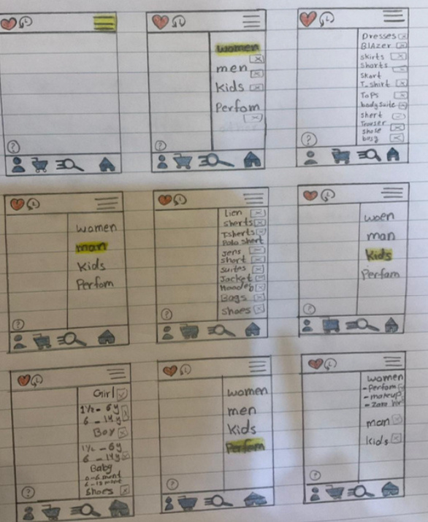
It was in two stages
The menu
The first. "low prototype"
The goals of the first stage are that errors are easy to correct and discover before designing the program, and that they are also low-cost
3- Design
In the list, we have designed this page so that the sections are clear and in an organized manner, and we have added pictures that indicate each section, and we have added to each section its own categories, and we have supported these categories with pictures that explain them, such as the dresses section. We have put a picture of a dress for clarification.

Slide 14
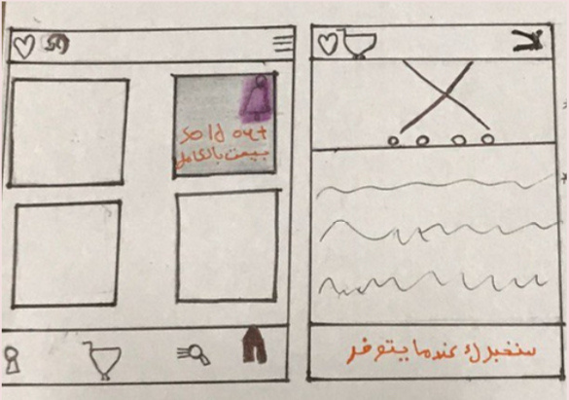
It was in two stages
Product unavailability
The first. "low prototype"
The goals of the first stage are that errors are easy to correct and discover before designing the program, and that they are also low-cost
3- Design
As for products that are not available, you will notice that the list says “unavailable” and there will be a bell for anyone who wants the application to send him a notification informing him when the product is available.

Slide 15
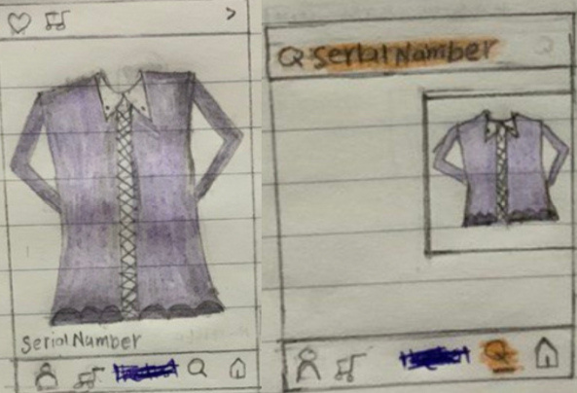
Serial number
It was in two stages
The first. "low prototype"
The goals of the first stage are that errors are easy to correct and discover before designing the program, and that they are also low-cost
3- Design
Customers faced a lot of difficult searching problems, so we found the perfect solution by placing a serial number for each product to facilitate the searching process for customers.

Slide 16
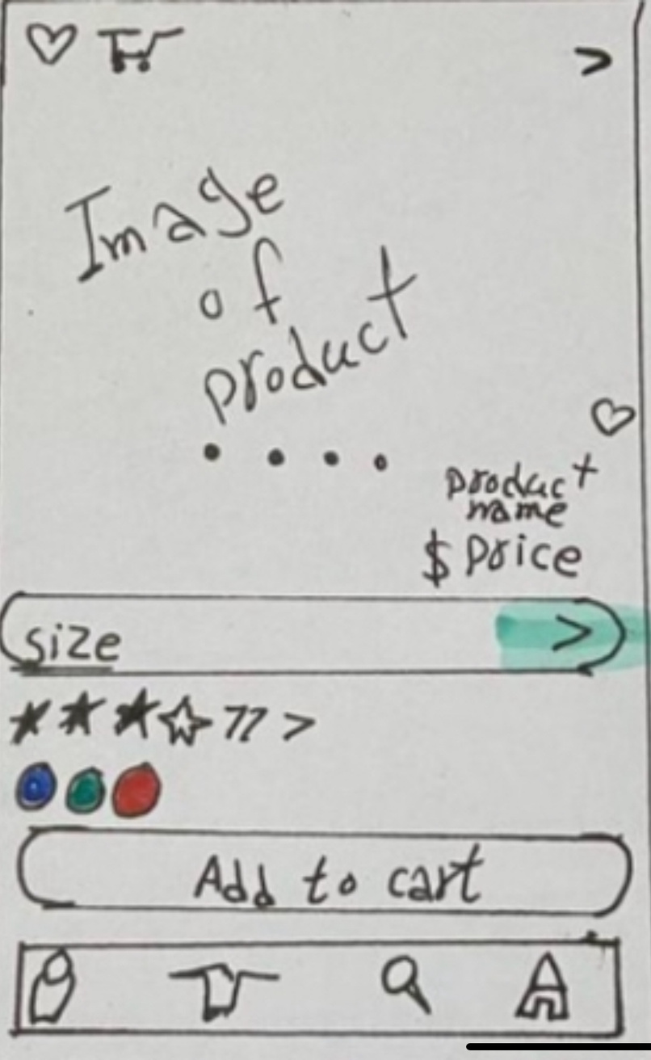
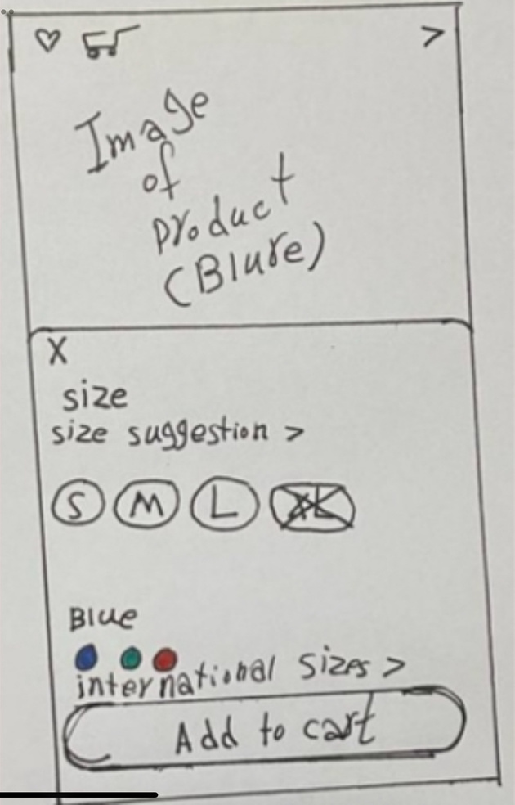
It was in two stages
Product details
The first. "low prototype"
The goals of the first stage are that errors are easy to correct and discover before designing the program, and that they are also low-cost
3- Design
As for the details of the product, we have made the images available for viewing by dragging. We have also added a rating list for the product

Slide 17
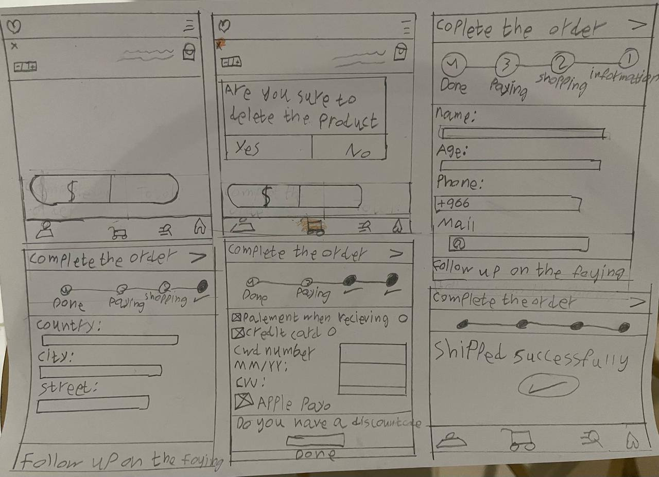
It was in two stages
Error message:
The first. "low prototype"
The goals of the first stage are that errors are easy to correct and discover before designing the program, and that they are also low-cost
3- Design
Because customers need a message that prevents them from making a mistake when deleting a product in the cart, if they agree, the product will be deleted, but if they do not agree, it will remain.

Slide 18
complete the order
It was in two stages
The first. "low prototype"
The goals of the first stage are that errors are easy to correct and discover before designing the program, and that they are also low-cost
3- Design
If you want to complete your application, you must complete it and Go to the Personal Information menu. If you complete it, go to Shipping information and enter your location information. If you complete it, go to the payment method. If you have The discount code, enter it and finally the order will be made It has been shipped successfully.

Slide 19
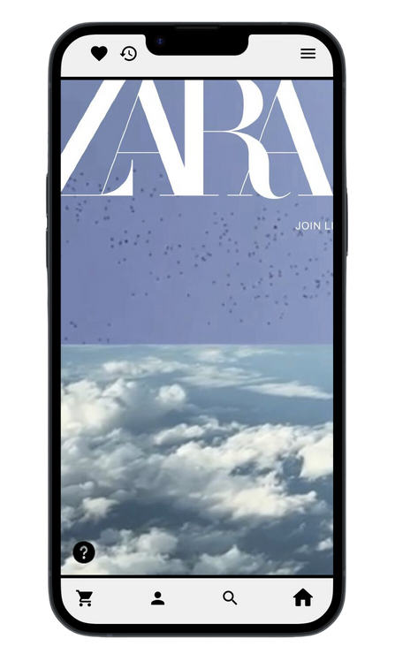
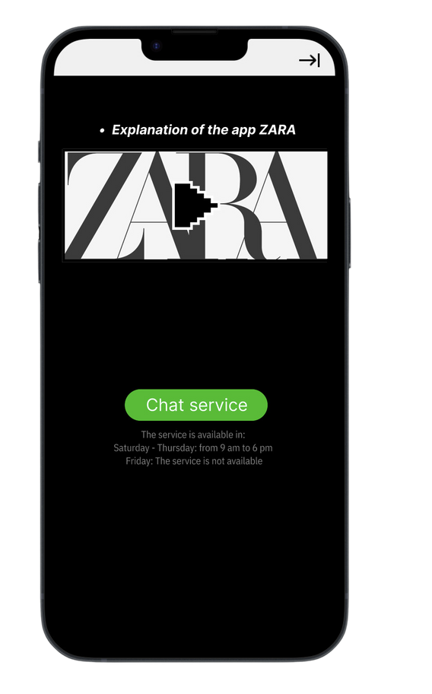

It was in two stages
Homepage
The second stage is "high prototype"
We used Figma, which is the final application form
Explanation of the application

Slide 20
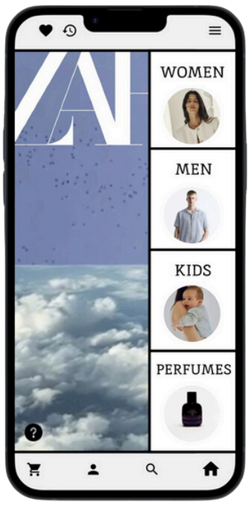
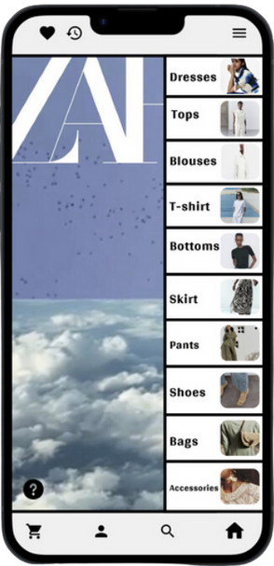
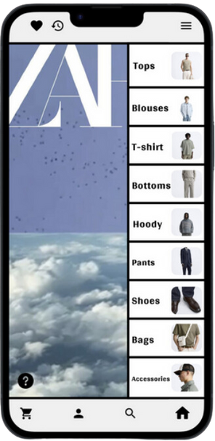
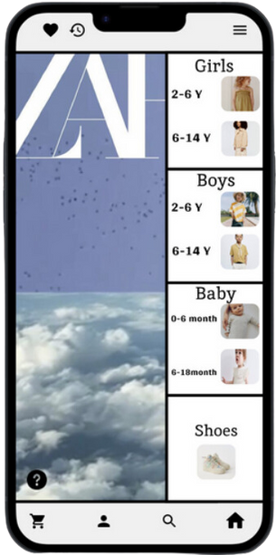
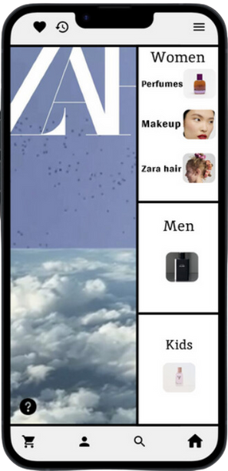
It was in two stages
The menu
The second stage is "high prototype"
We used Figma, which is the final application form

Slide 21
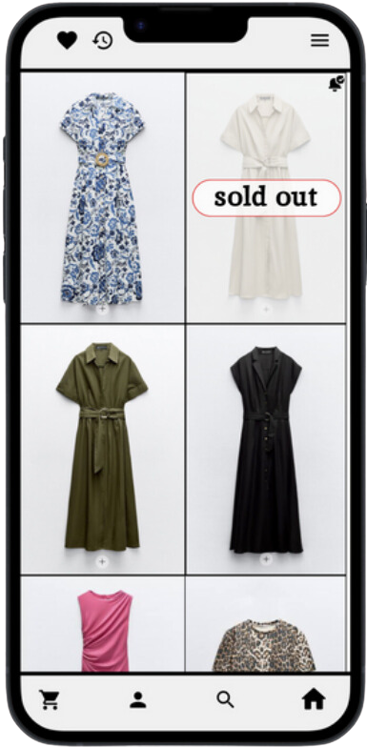
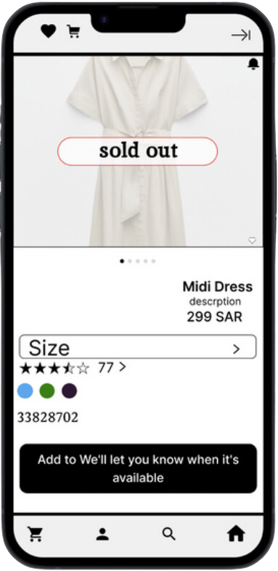
It was in two stages
The second stage is "high prototype"
Product unavailability:
We used Figma, which is the final application form

Slide 22
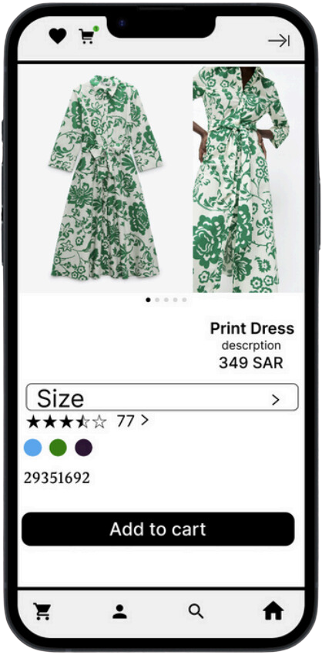
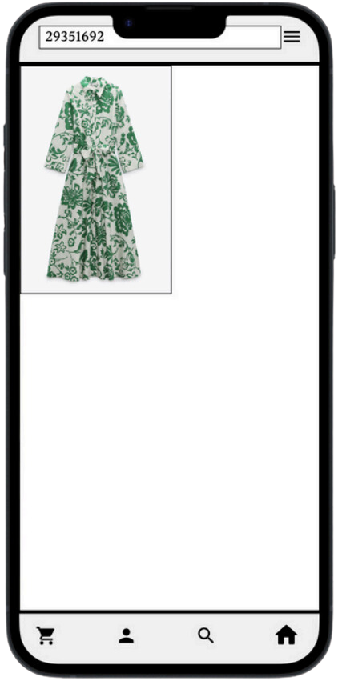
It was in two stages
Serial Number:
The second stage is "high prototype"
We used Figma, which is the final application form

Slide 23
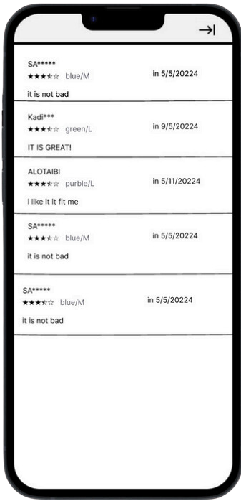
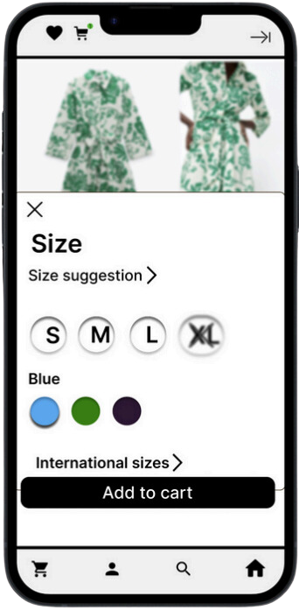
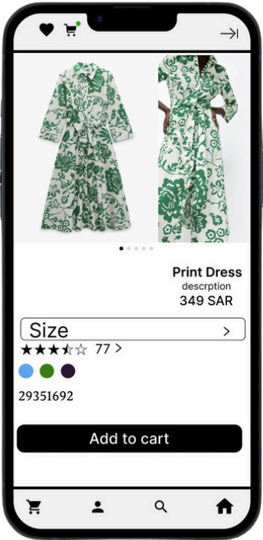
It was in two stages
Product details:
The second stage is "high prototype"
We used Figma, which is the final application form

Slide 24
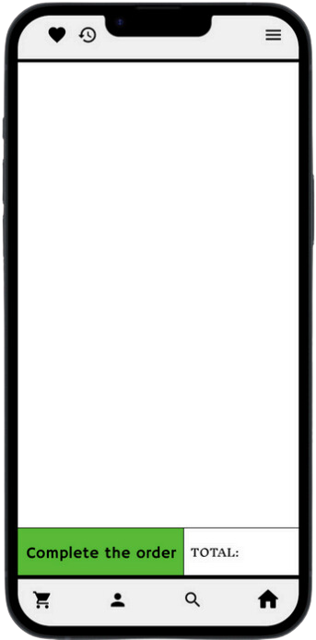
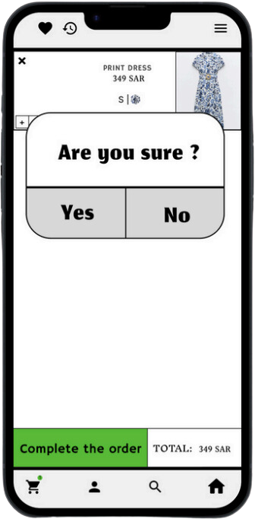
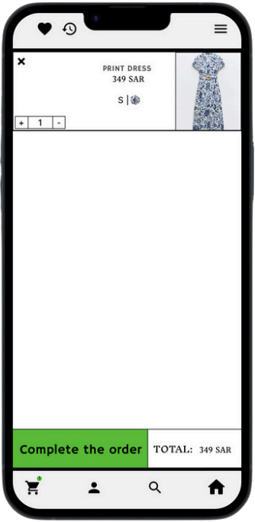
It was in two stages
Error message:
The second stage is "high prototype"
We used Figma, which is the final application form

Slide 25
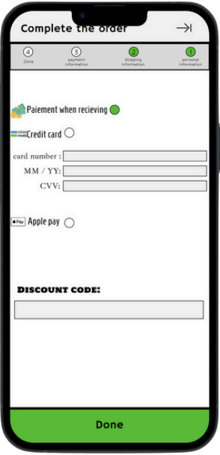
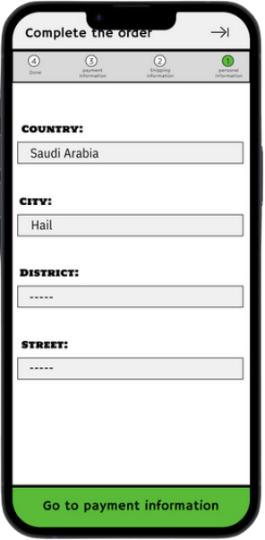
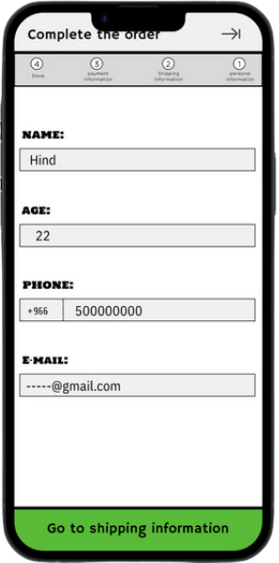
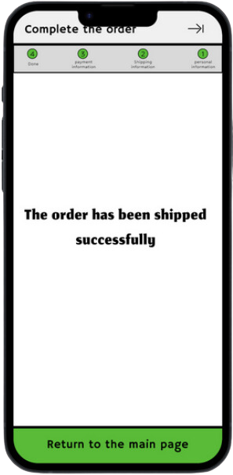
It was in two stages
The second stage is "high prototype"
Complete the order:
We used Figma, which is the final application form

Slide 26



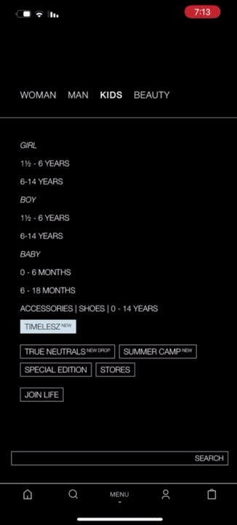

New design
Old design
evaluation

Slide 27


Conclusion
At the beginning of the project, we chose the Zara application, then we looked at it and took out the 3 most prominent problems in it and asked it about it, then we sent an online survey to a group of people about the evaluation of the Zara application, and we collected more than 20 responses, then we drew the problems that we want to improve by applying Zara on, Paper and pen and collected them, and then we applied the drawings on the Figma tool design, to solve those problrms.
In the next slide we will review the three problems ..

Slide 28
Lack of guidance and guidance: Users may have difficulty obtaining the necessary guidance and guidance in the Zara program. There may be a lack of explanation of how the app will be used, and users may feel lost regarding the next steps or functions available.
To solve this problem, we have added an option to explain the application
Its goal for the user is for the user to learn how to order as well, so that he doesn't feel confused and afraid when using the application
Customers had a lot of consistency issues and we addressed them.
We changed the location of the menu and added pictures. - The product list. We added the phrase “not available” for unavailable products. - We added a rating list for the product details, and displaying product images by dragging. - We added a warning message to the shopping cart. - We added an indicator to track the order.
It helps the user how to use the functions correctly and in the way he is accustomed to.
Difficulty searching for products.
We have assigned a serial number to each product.
This facilitates the search process and saves time and effort for the user.

Slide 29

Any Question?

Slide 30


Thank You For Listening

